Slide 1
What is an appropriate measure to recommend movies?
K Shreyas Rao

Slide 2


Slide 3
Use of Big data in movie recommendation systems.
Movies can be recommended based on average rating by users, but should all the user ratings be considered?

Slide 4
My dataset and implementation details
I have used Movielens dataset from http://grouplens.org/datasets/movielens/
Files are Movies.csv, Ratings.csv, Tags.csv
userId,movieId,rating,timestamp
1,253,3.0,900660748
1,1387,3.0,900660748
1,1407,5.0,900660871
1,1717,5.0,900660871
1,1876,3.0,900660543
1,1882,3.0,900660584

Slide 5
My work
Dealing with Hadoop and HDFS
Use of MRJob module in Python
Cleaning of data using simple linux commands (tr, sed)
Analysis of output data

Slide 6
Sample output in csv format
MovieId, No. of Ratings, Average Rating
1, 54145,3.9218118016437344
10, 30656,3.4379240605427976
100, 4365,3.2349369988545247
1000, 208,3.09375
100003, 3,3.6666666666666665
100006, 1,2.5

Slide 7
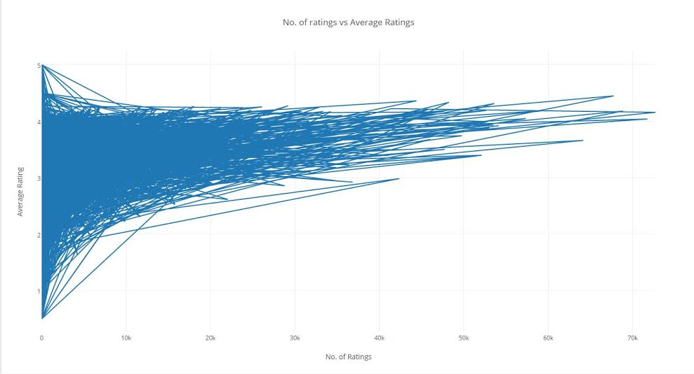
A graph of Number of ratings vs Average Rating.

Slide 8
Future Work
Append average rating column to movies dataset and visualize similar graphs for each genre and year to analyse the trends over time.

Slide 9
Questions?

